Slide 1
Recap
An Overview of Maintenance of PID Control Systems in Industry

Slide 2
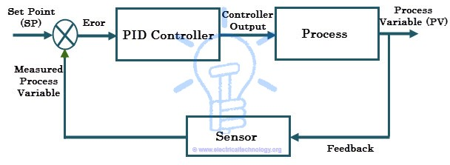
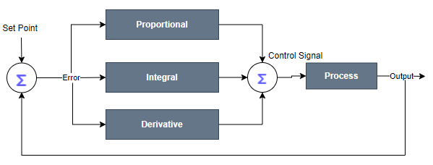
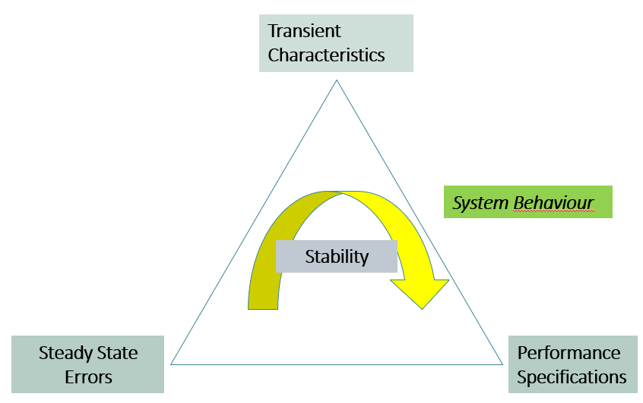
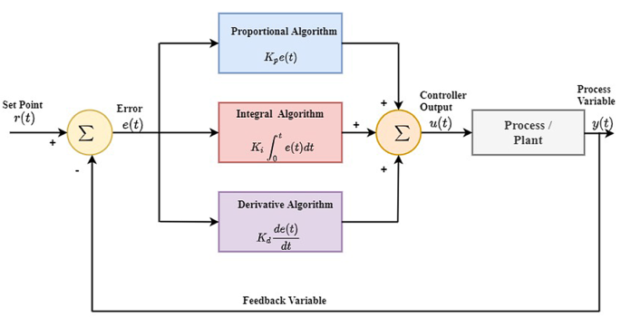
Maintenance of PID Control Systems in Industry

Slide 3
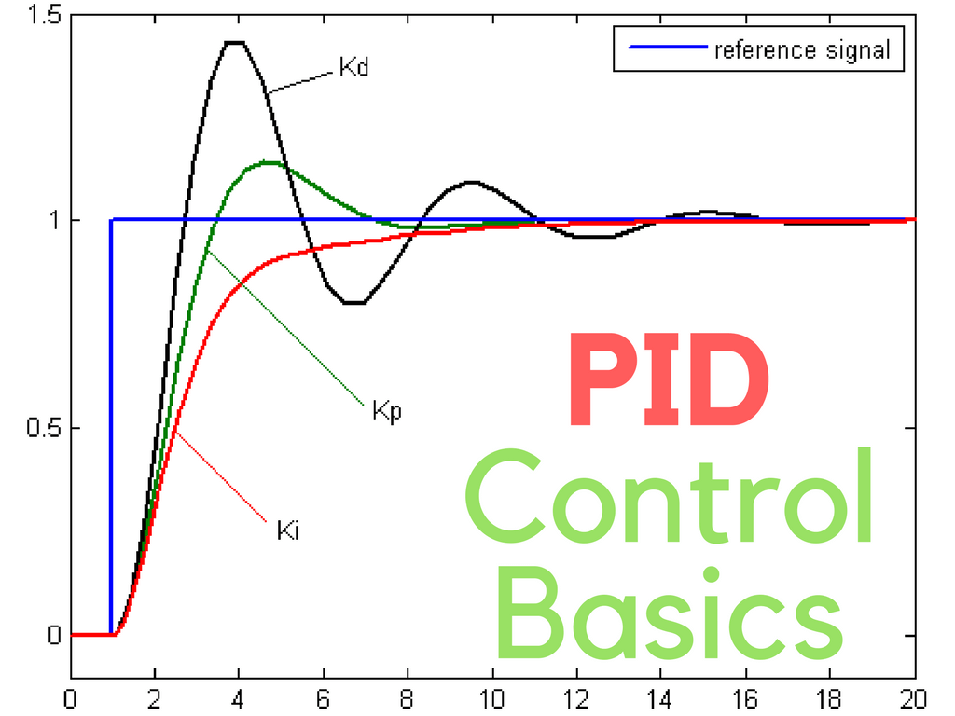
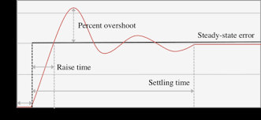
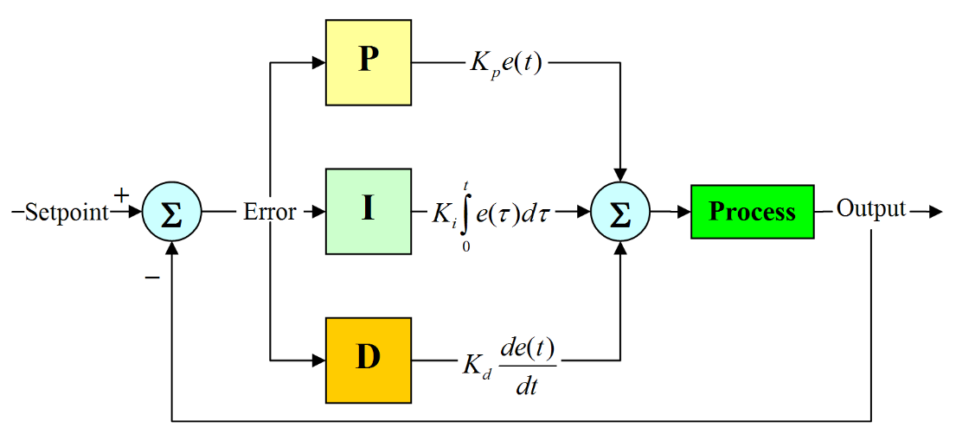
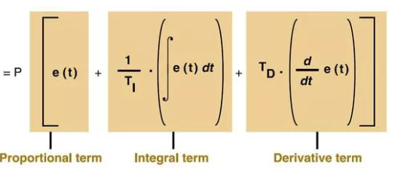
Understanding the PID Controls

Slide 4
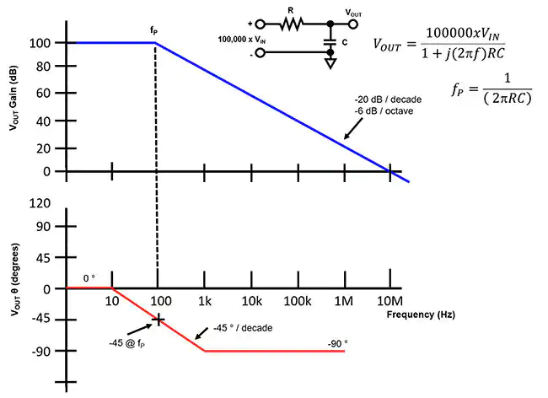
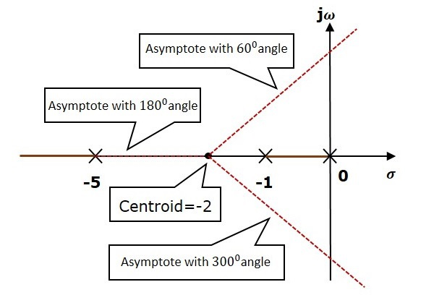
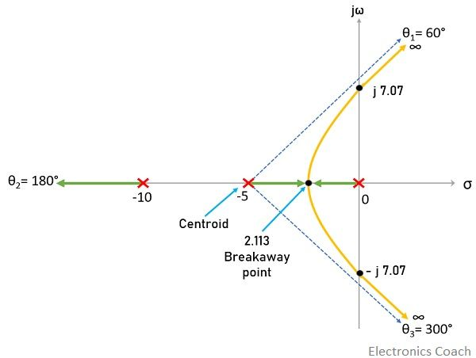
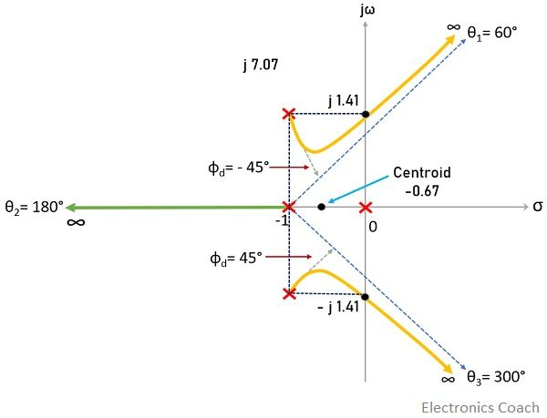
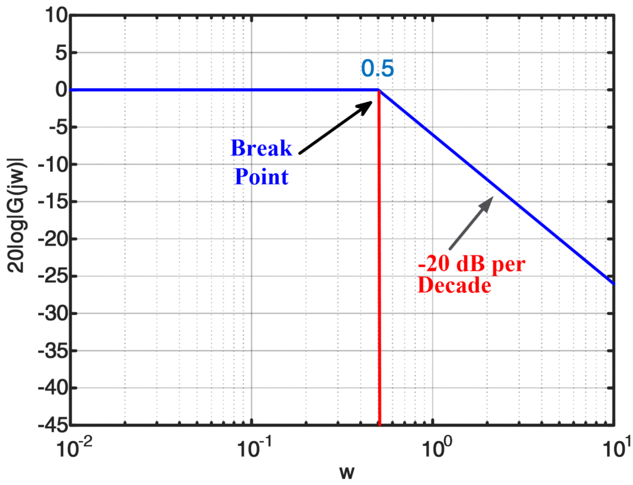
Evaluating Controllers

Slide 5
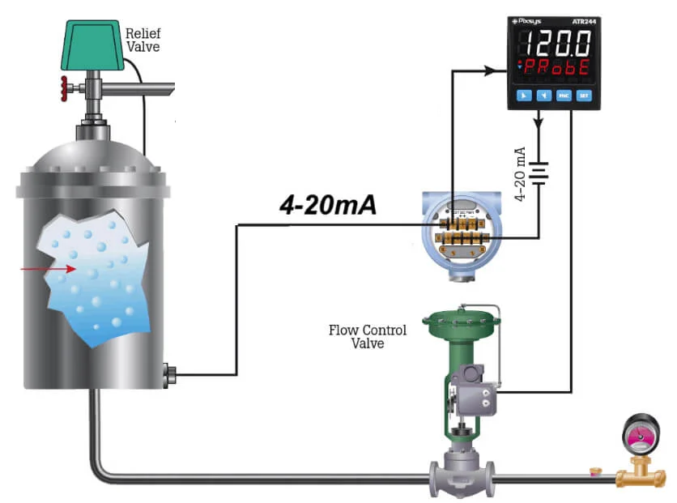
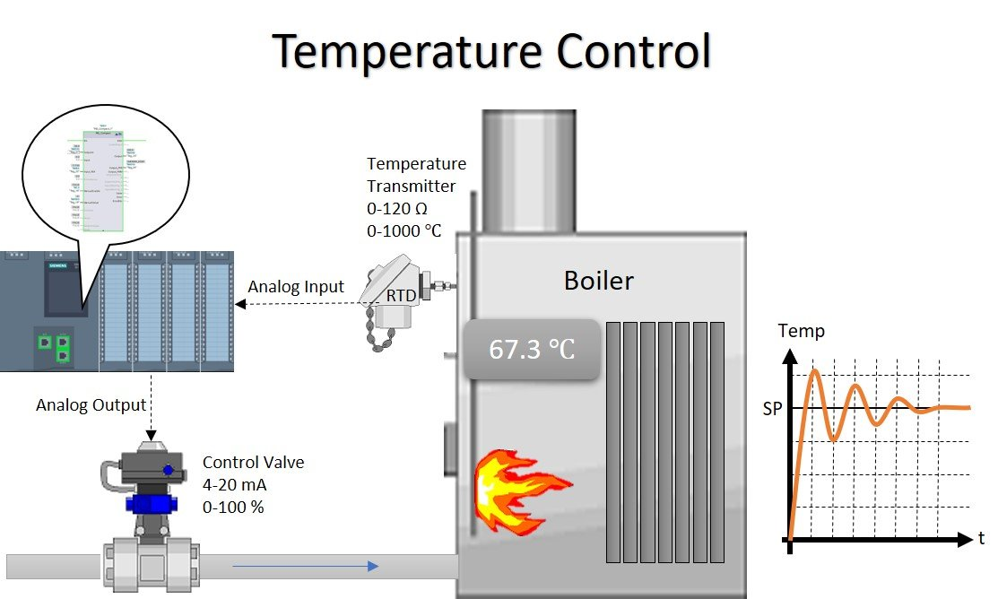
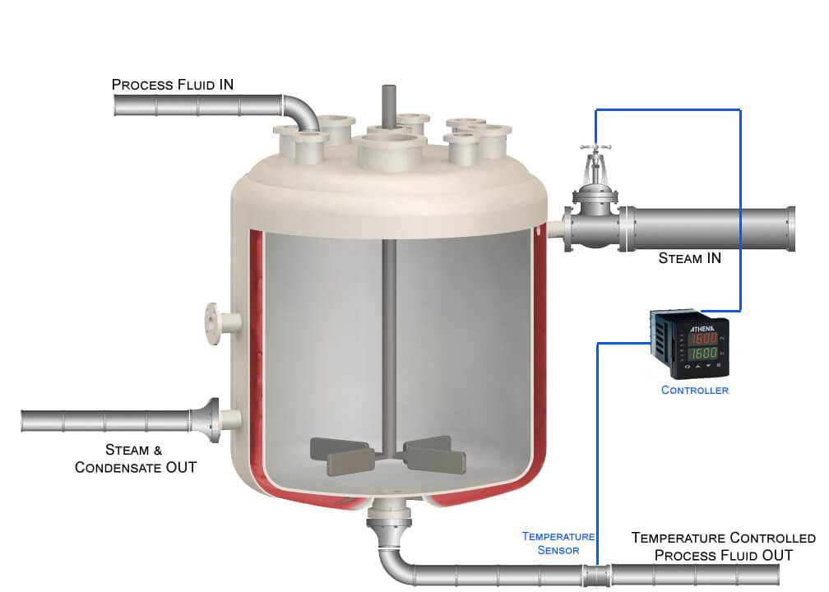
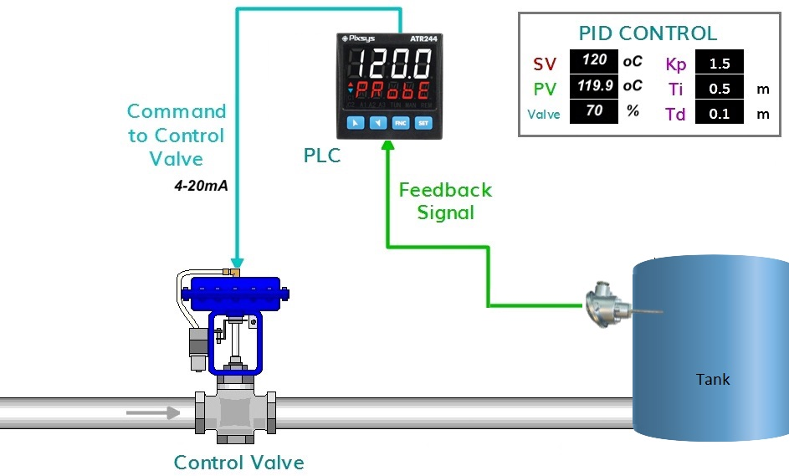
A Few Industrial Examples

Slide 6
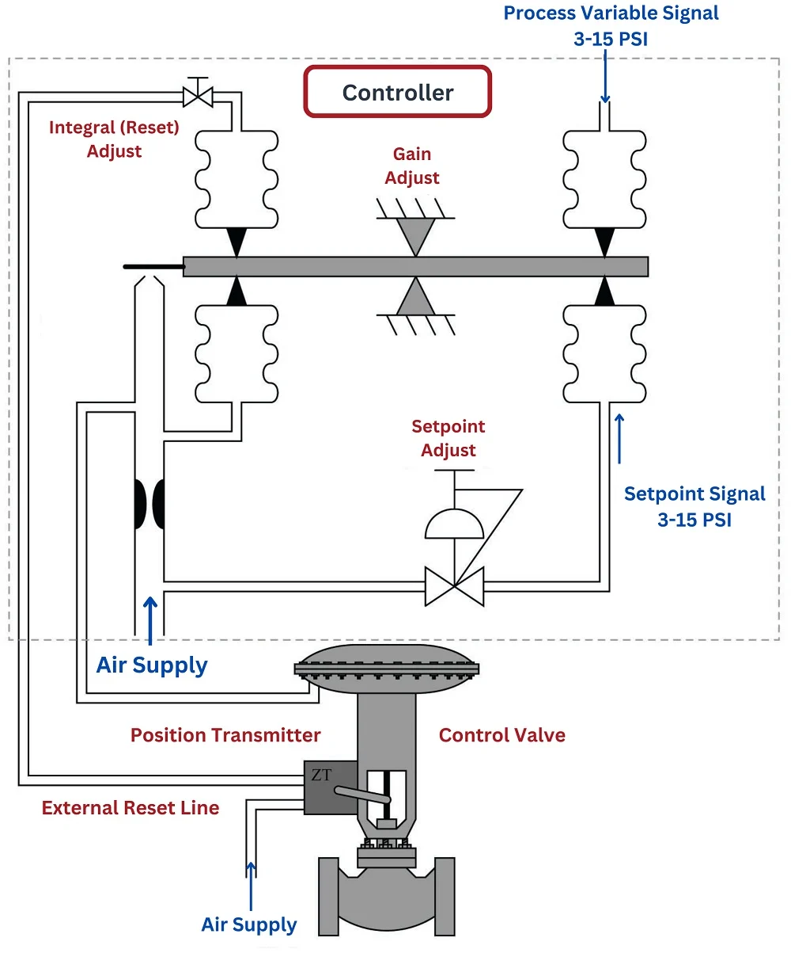
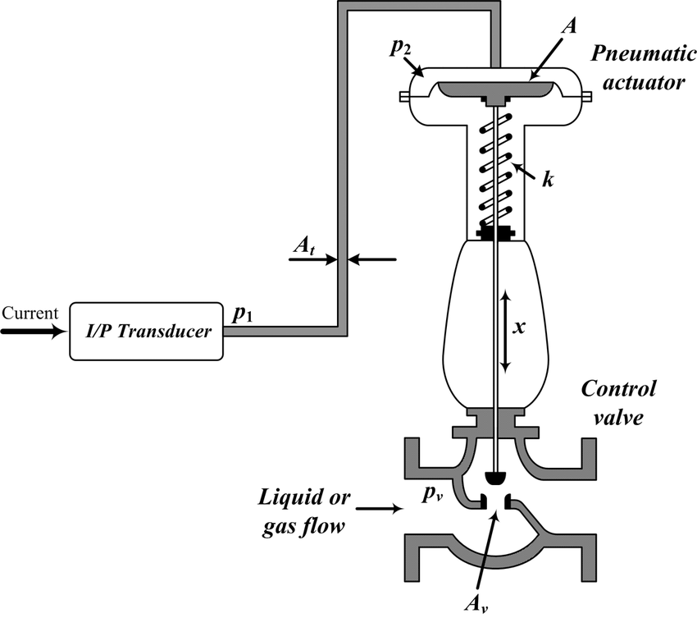
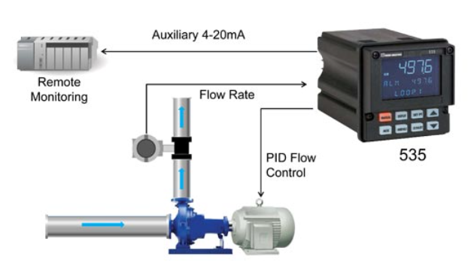
A Few Industrial Examples

Slide 7
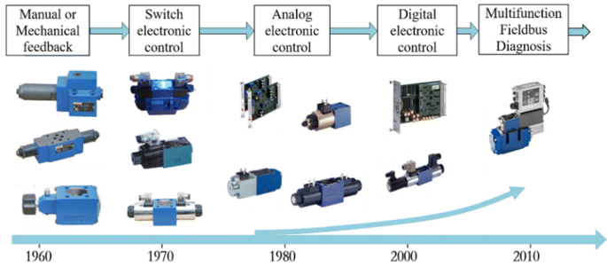
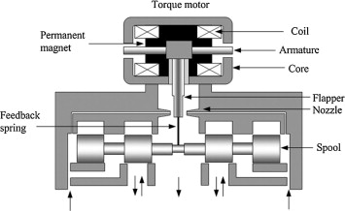
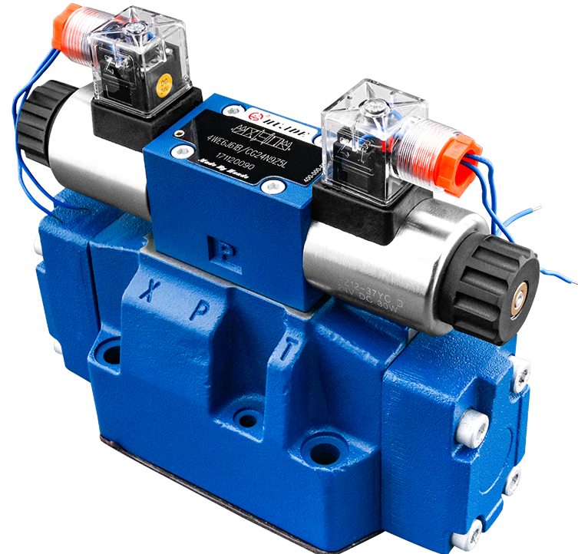
A Few Industrial Examples

Slide 8
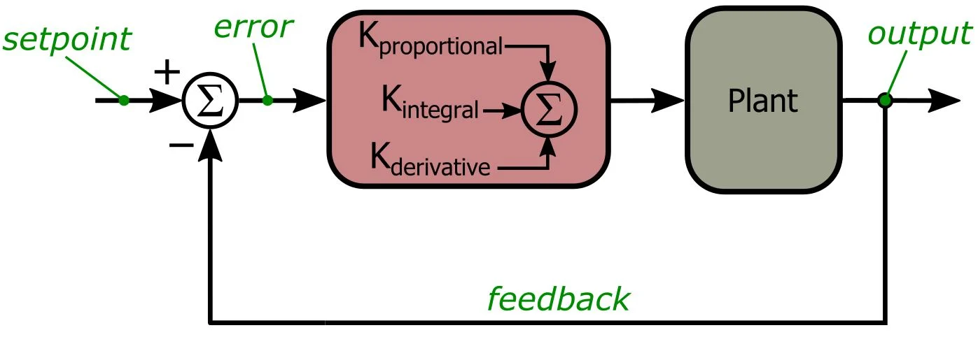
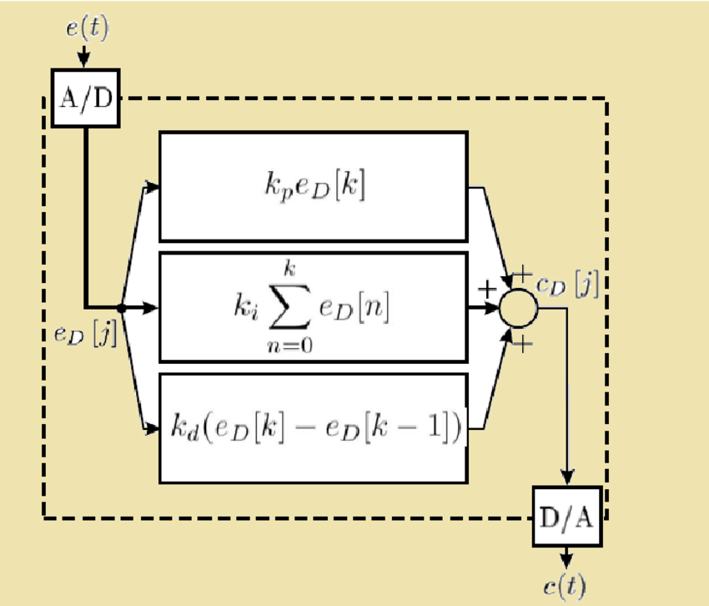
Implementation in Digital Domain

Slide 9
Introduction to Non-Linear Estimation

Slide 10
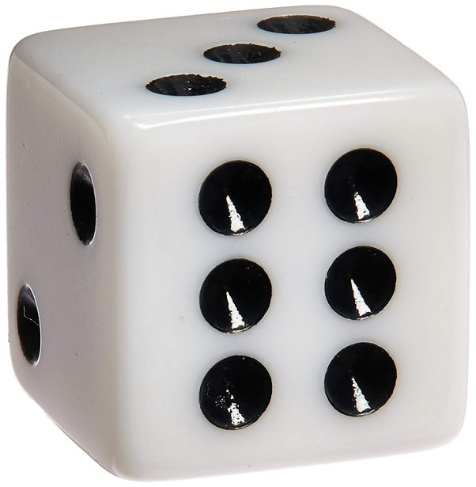
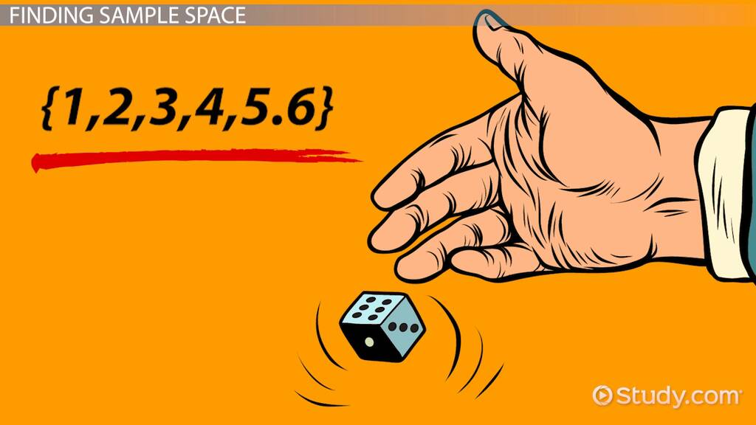
Lecture-11-B
randperm

Slide 11
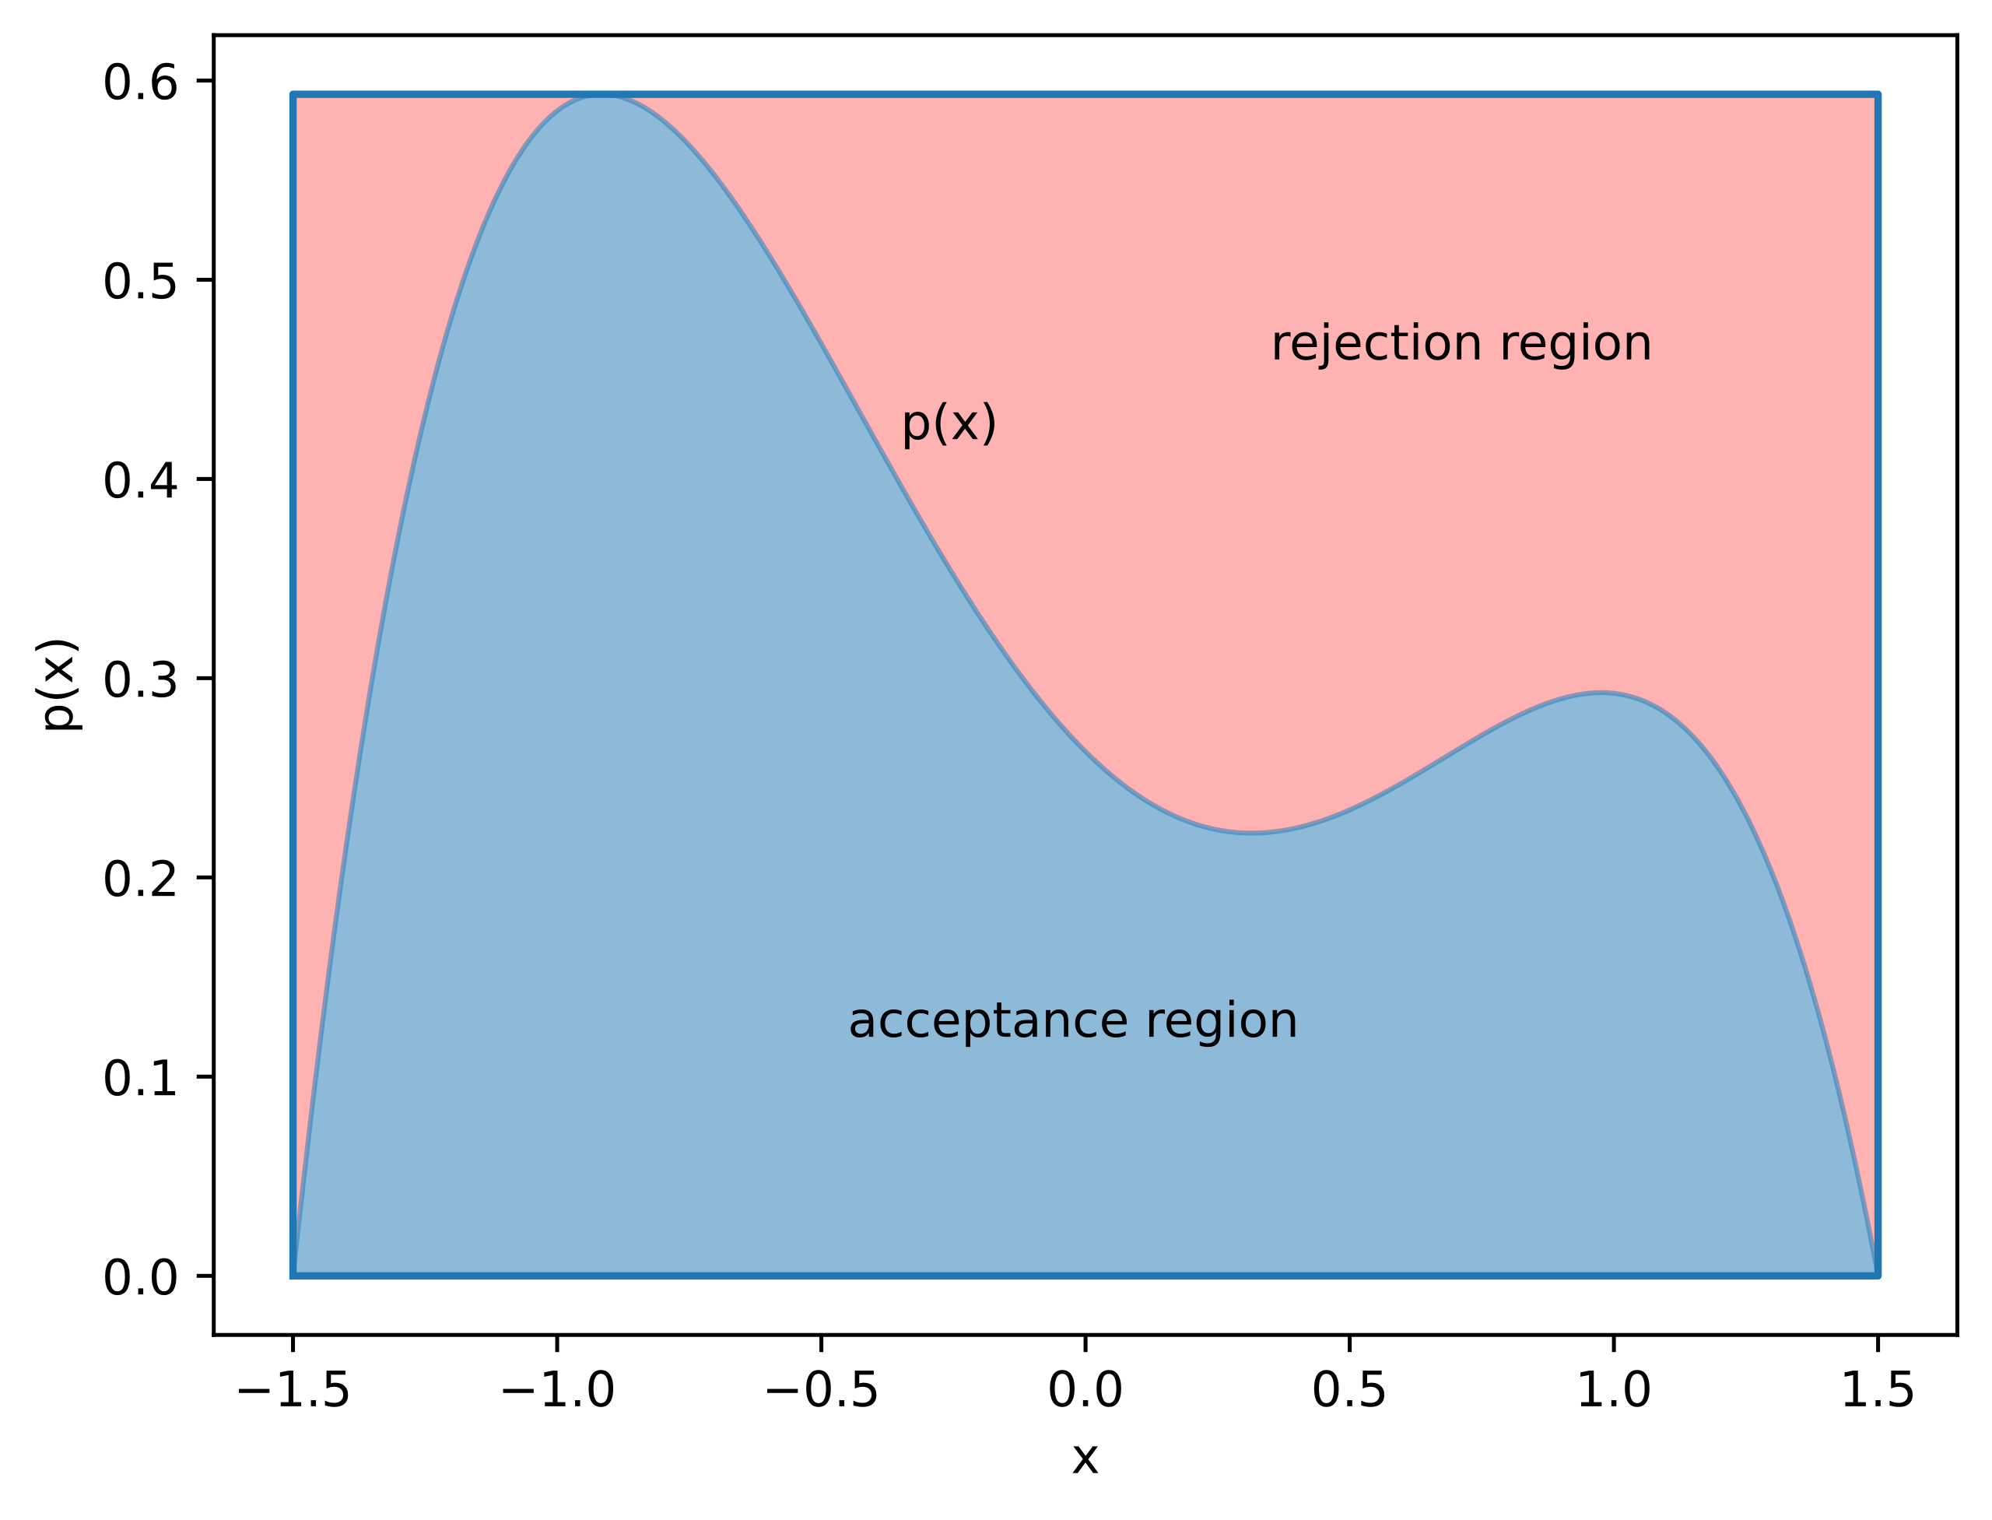
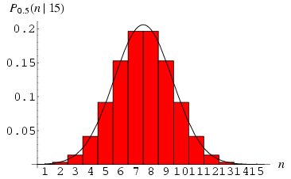
Monte Carlo Methods
Less Theory, More Simulation

Slide 12
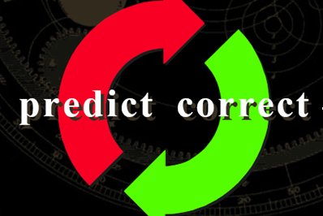
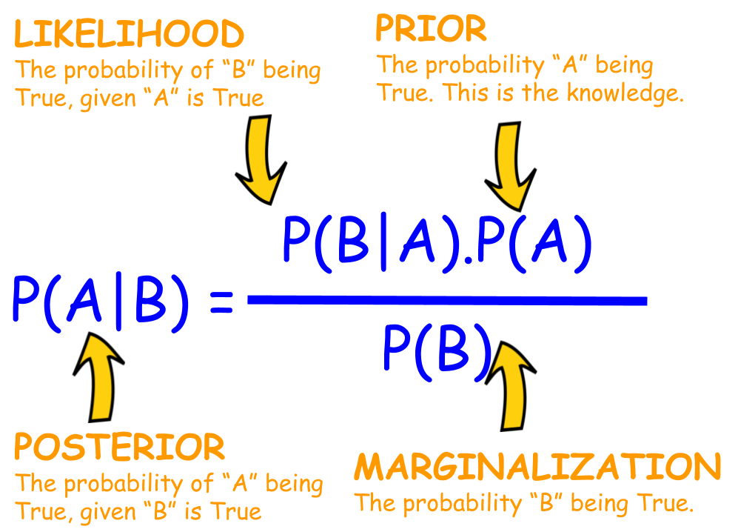
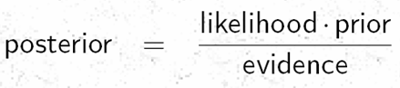
Non-Linear Filter with Non-Gaussian Uncertainties in the Bayesian Framework
Update
Propagation of a Conditional Density Function
(k-1)+
(k)-
(k)+
k-1
Prediction
k
z(k-1)
z(k)

Slide 13
Bayesian Filtering/Estimation for Non-Linear Systems with Non-Gaussian Process & Measurement Uncertainties
State Variable Representation of Dynamical Systems, which are Strongly Non-Linear

Slide 14
Components in a Bayesian Approach
State Vector : x_{k}
Measurement Vector: z_{k}
Initial pdf: p(x₀)
Likelihood pdf: (from model) p(z_{k}|x_{k})
Prior pdf: p(x_{k}|z_{1:k-1})
Posterior pdf: p(x_{k}|z_{1:k} )

Slide 15
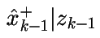
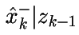
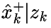
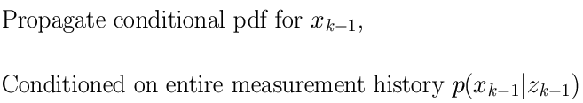
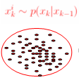
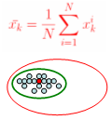
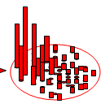
Particle Filtering --- Similar Recursions, but with a Difference
Instantiating
Re-sampling
X(k) = f[x(k-1), Bu(k-1)] + w(k-1)
Update
(k-1)+
(k)-
(k)+
k-1
k
z(k-1)
z(k)
X(k) = Ax(k-1) + Bu(k-1)

Slide 16
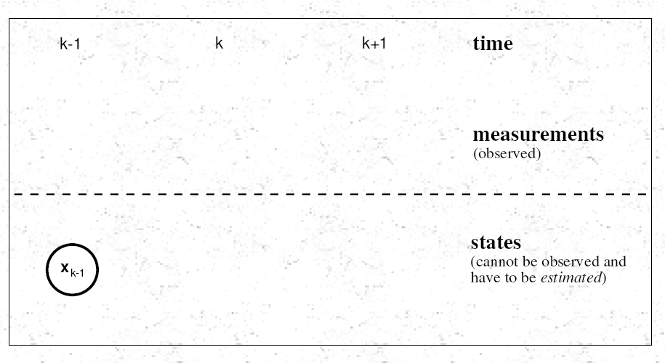
Propagating from (k-1) to (k) to (k+1)

Slide 17
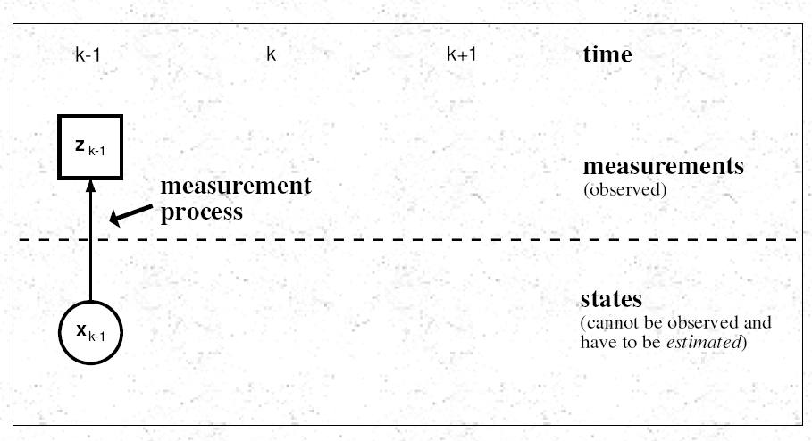

Slide 18
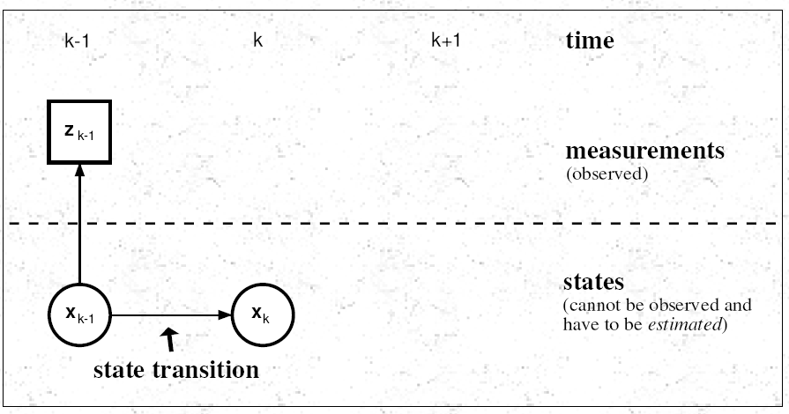

Slide 19
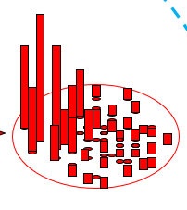
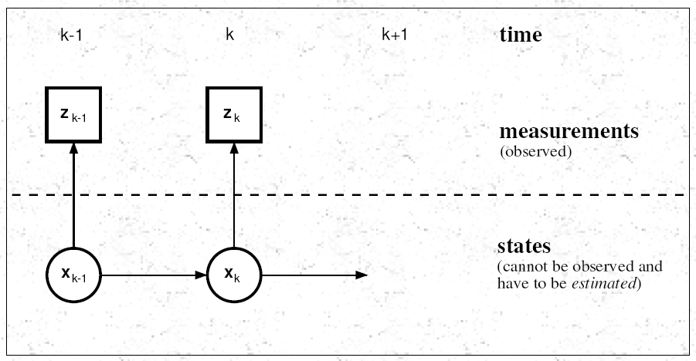
Re-sampling

Slide 20
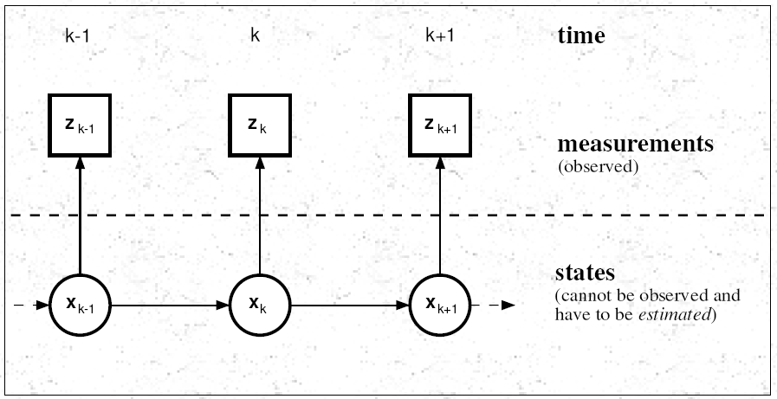
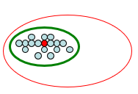

Slide 21
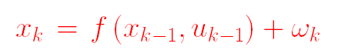
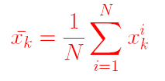
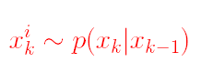
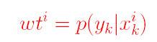

Sequential Importance Re-sampling/Particle Filter

